Slide 1
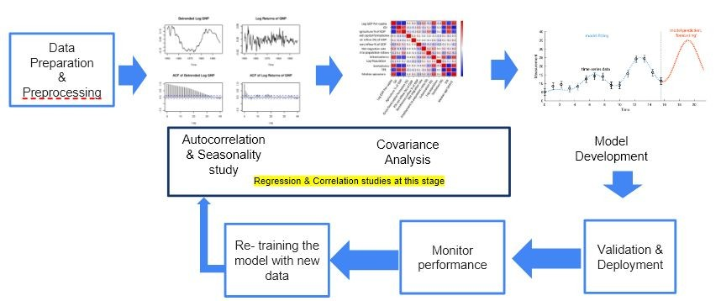
Problem Statement: Social Impact Analysis using NTL data on various socio‐economic factors.
Explain your understanding on Problem Statement: In this project, we aim to use NTL data to ﬁnd its correlation with various socio-economic factors to try to understand how it affects urbanization trends, road infrastructure, public health expenditure etc. This data also determines the economic status of rural areas.
Brief about your approach: To study the impacts of NTL on Socio economic parameters and understand the correlations and build forecasting models on the time series data. Combining the inputs from the NTL data and that from RBI, MOSPI and state govts, we attempt to build forecasting models. Model provides the insights and plan for changes of migration trends and its impact based on NTL data.

Slide 2
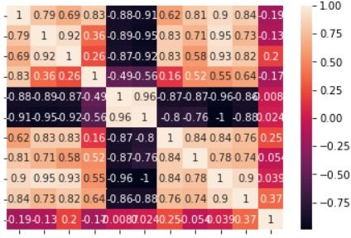
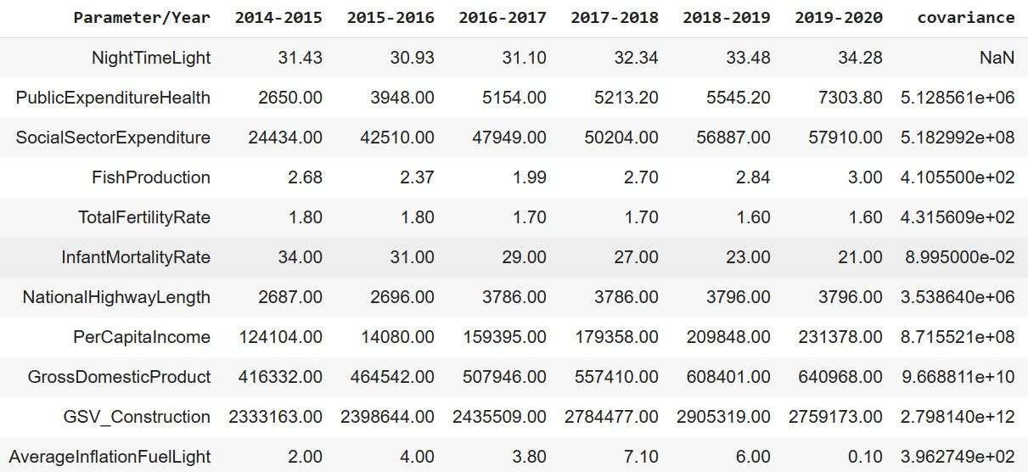
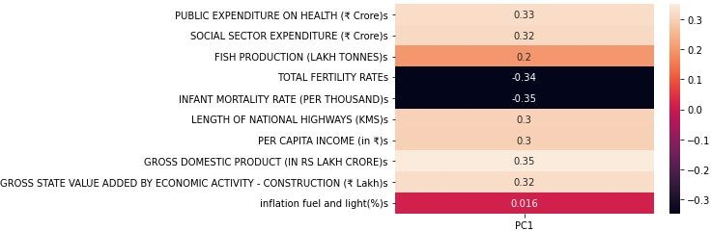
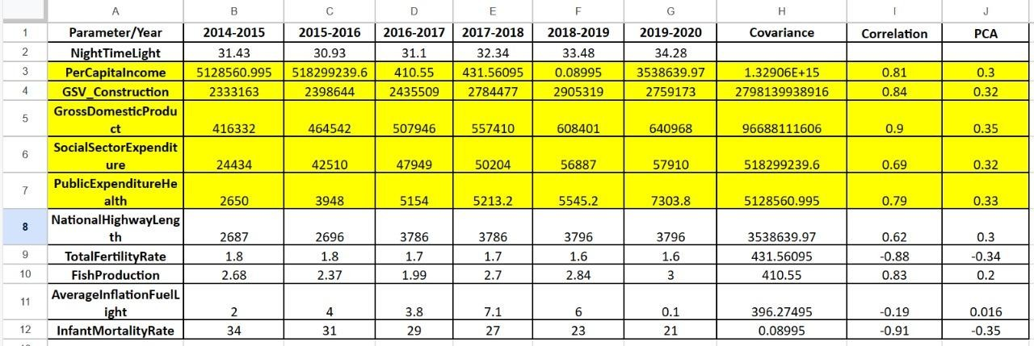
DETAILED APPROACH: STEP I. Shortlisting Strongly Correlated Socio-economic Factors
Correlation analysis Covariance analysis
Principal Component analysis
Shortlisted Socio-Economic Factors

Slide 3
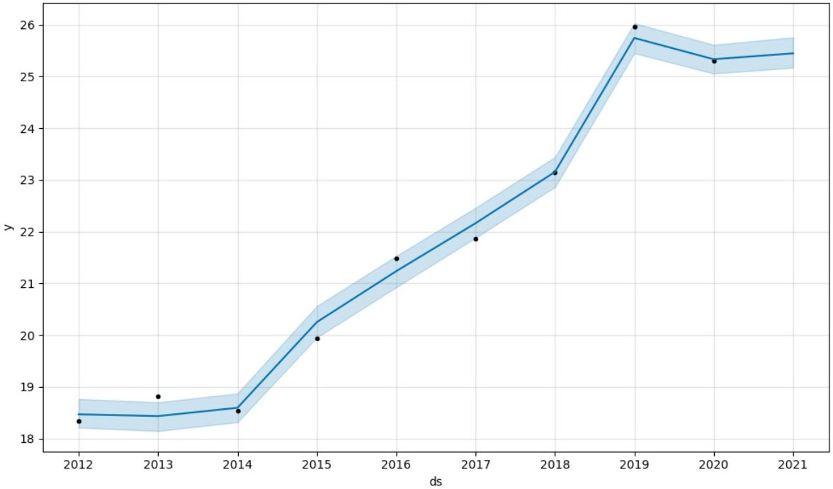
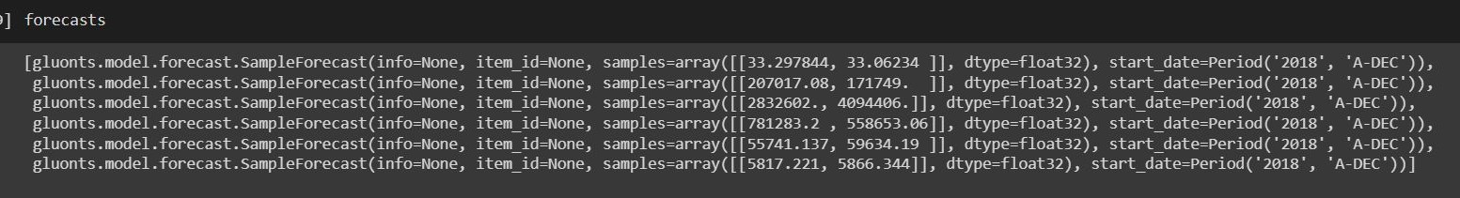
STEP II. Multivariate Time Series Regression Analysis Models - Top Correlated Socio-economic Factors a.) FbProphet
Based on the previous years data from 2012-2020, multivariate regression is performed adding the following regressors: GDP, per capita income, Gross state value for road construction.
b.) DeepAR
According to DeepAR model, the predictions for the future years is made through multivariate regression method.

Slide 4
Expected outcomes
Establish forecasting models for Socio-Economic parameters based on their correlations & also NTL predications to cross validate.
GDP(t) = a * NTL (t -1) + b * ( Farming and/or employment and /or electricity consumption) + Tracking Error
NTL (t) = a1 * GDP (t -1) + b1 * ( Farming and / or Roads and / or employment and /or electricity consumption) + Tracking Error
Tools/models/APIs and devices used on development
References/Acknowledgement
Google Colaboratory
FbProphet
DeepAR
Vector AR
Python
Han G, Zhou T, Sun Y, Zhu S. The relationship between night-time light and socioeconomic factors in China and India. PLoS One. 2022 Jan 13;17(1):e0262503. doi: 10.1371/journal.pone.0262503. PMID: 35025972; PMCID: PMC8758086.
Lu Y, Coops NC (2018) Bright lights, big city: Causal effects of population and GDP on urban brightness. PLoS ONE 13(7): e0199545. doi: 10.1371/journal.pone.0199545
Technologies involved/used
Machine learning/Deep learning
Data science

